Slide 1
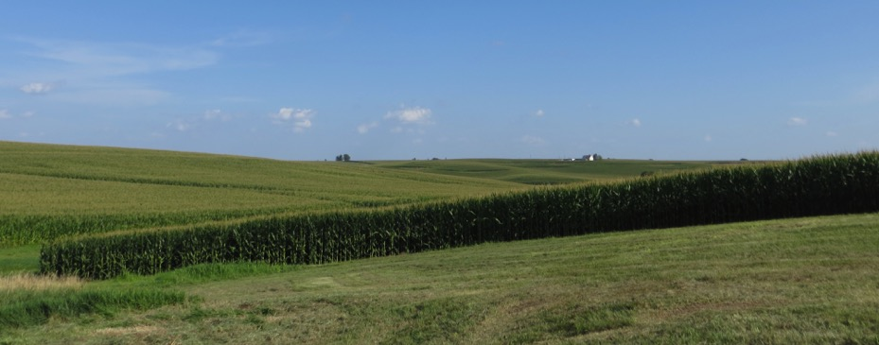
Temporal Information Partitioning Networks (TIPNets)
A star-studded tutorial Coming NOW
to the Second Workshop on Information Theory in the Geosciences
5/19/2018
Allison Goodwell and Praveen Kumar
https://github.com/HydroComplexity/TIPNet

Slide 2
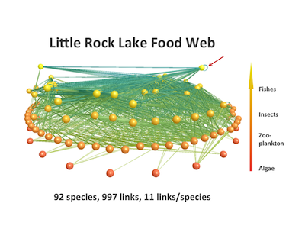
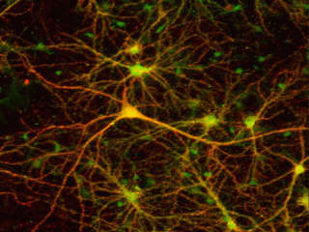
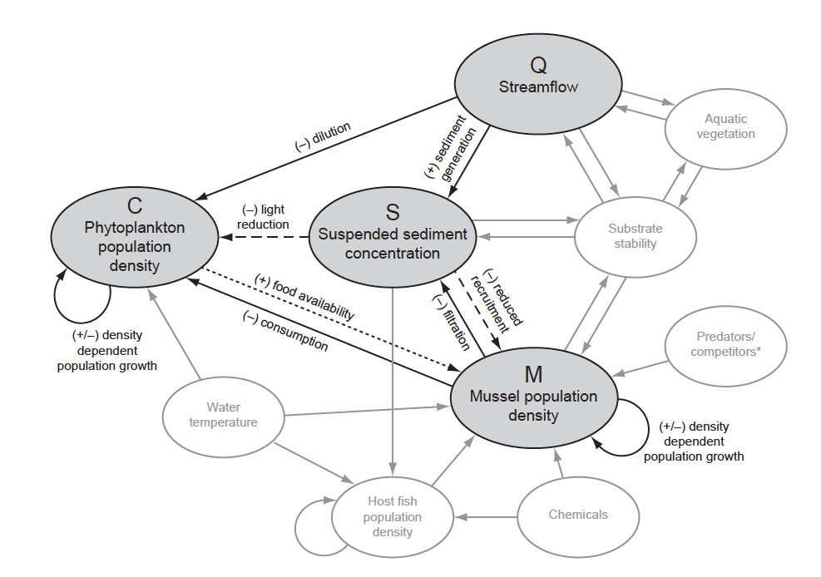
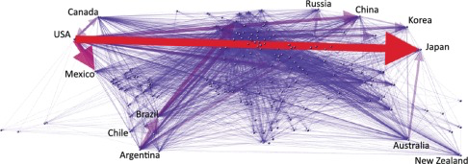
the world is full of complex networks
the human brain
species
ecohydrologic fluxes
global trade
we must understand the network structure in order to understand system behavior
Notes:
http://monkeybuddha.blogspot.com/2006_05_01_archive.html
Konar et al 2012
https://www.complexityexplorer.org/news/26-the-web-of-life-and-the-ecological-human-in-summary

Slide 3


observations enable partial reconstructions
we take some measurements to get a closer look at how components vary with time.
we can partially reconstruct the system and understand variability in terms of process connectivity

Slide 4


for example, we can consider an ecohydrologic system as a network of interactions
components vary jointly and have a wide dynamical range
cloud movement
heating
water vapor
capacity
weather
events
mixing
we can reveal aspects of joint variability with a process network approach.
evaporation
heat flux
partitioning
plant water uptake

Slide 5

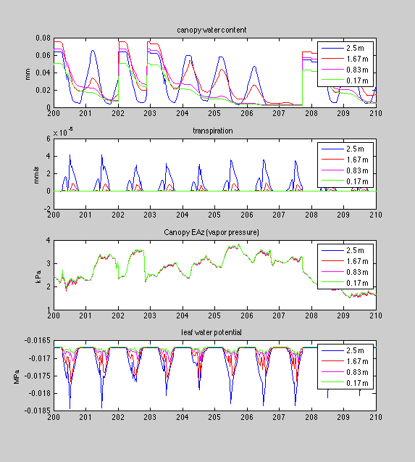
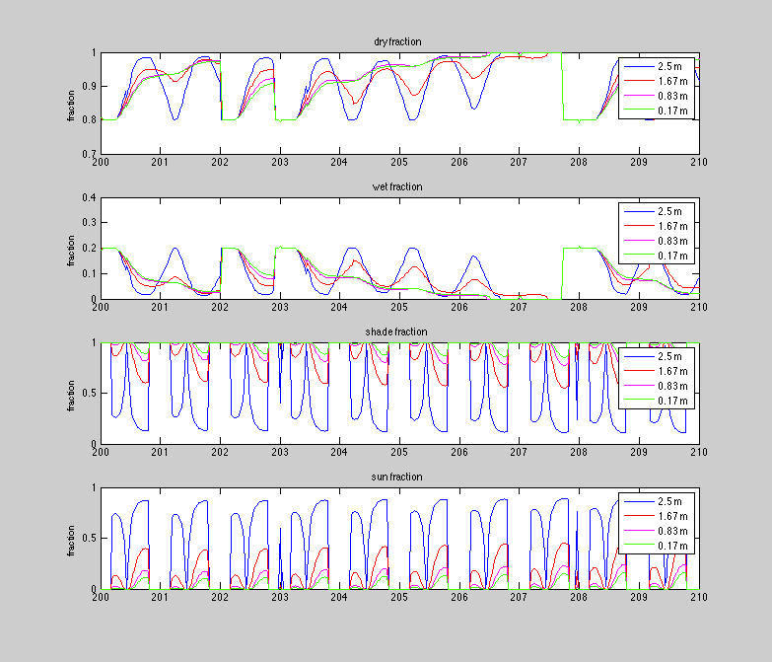
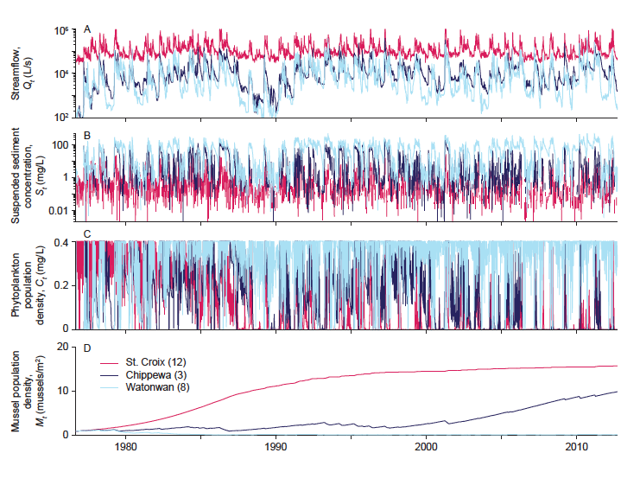
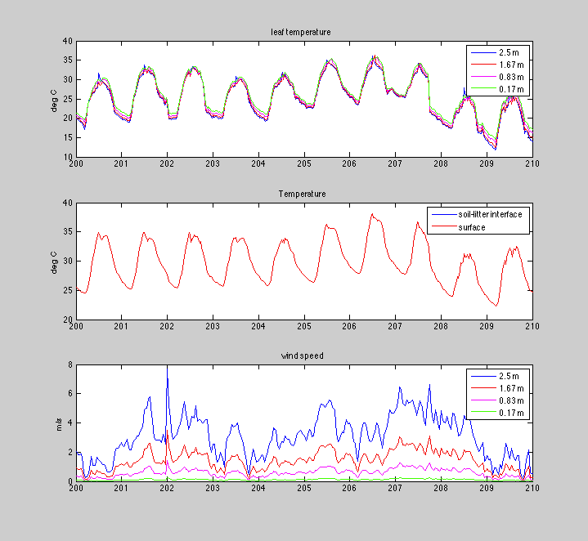
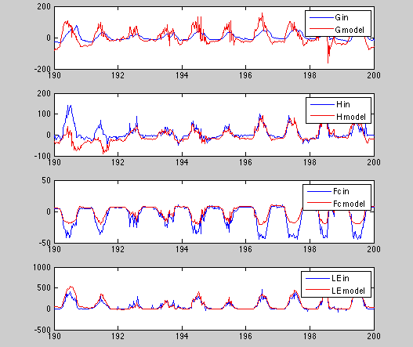
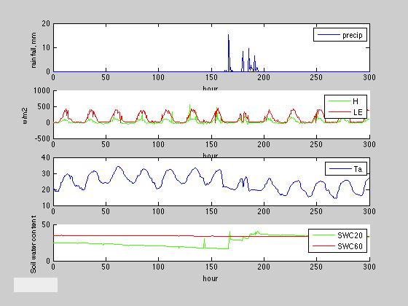
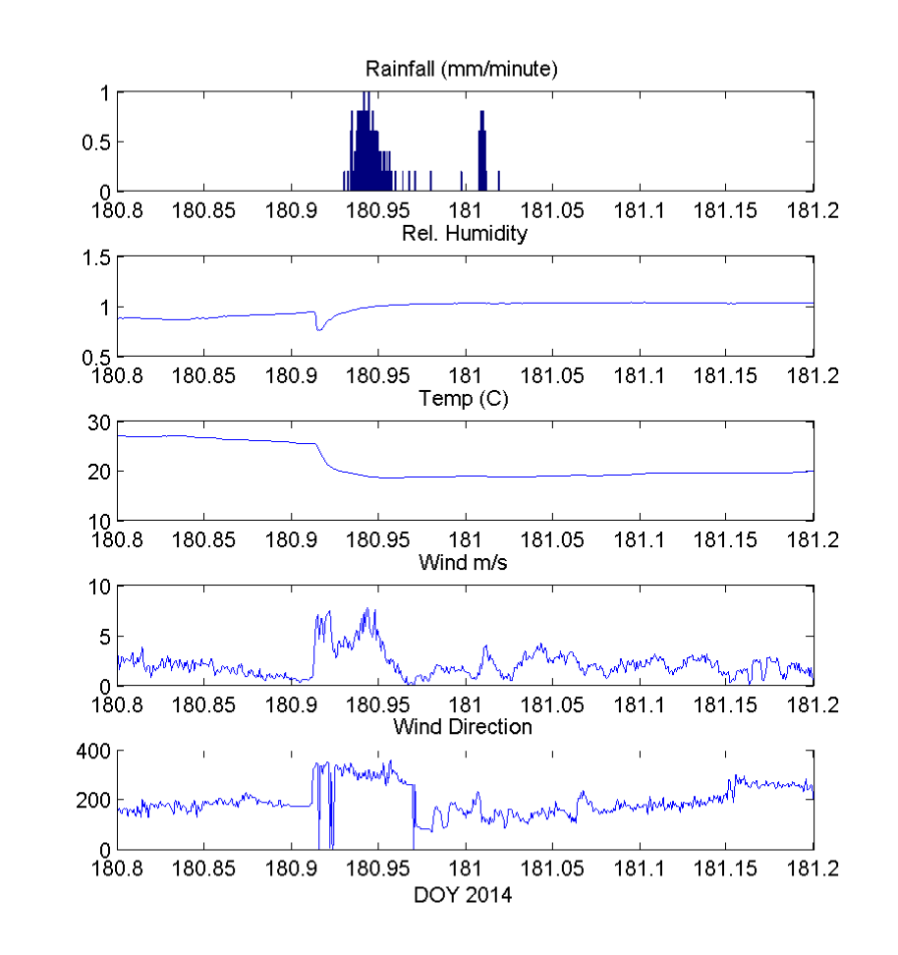
luckily, we are floating on a sea of data
but risk the unsuccessful conversion of information to understanding….
What does it all mean!?!?
Uh oh…
AAAH!
SOS!

Slide 6
we consider a process network in which nodes are time series
Strength
How dominant is the link?
Time Scale
Does link occur at fast or slow timescale?
Redundancy
Is the link unique, or redundant due to feedback?
Synergy
Does the link provide additional information with another link?
X₁
X₂
question: how can we identify these links?
X₃
information theory measures
…
time
Notes:
second, we’ll consider framework where time series variables are nodes in a network. we want to draw links between these nodes – links should have a certain strength, time scale of interaction, and could be redundant due to other links or feedback, or work together with other links in a synergistic way. back to the question – how to identify these links that represent interactions? -IT

Slide 7
we capture time dependencies using information theory
entropy is uncertainty
X_{s1}
τ_{s1}
node view
X_{tar}
mutual information is a reduction in uncertainty
X_{tar,} _{τ}
entropy view
transfer entropy is a further reduction in uncertainty
total information from two sources to target
Notes:
for a single “target” node, we can estimate a pdf and compute its entropy, or it’s uncertainty. top view shows nodes, bottom illustrates values of entropy
if we add some lagged “source node”, the mutual information is the reduction in uncertainty of the target given knowledge of the source, “entropy overlap”
If we condition that information on an additional source, say the history of the target node itself, we get a further reduction in uncertainty with conditional mutual info, in this case TE.
the shared information between both source nodes to the target is the total mutual information, which is what we’ll be working with further

Slide 8
transfer entropy measures “reduction-of-reduction” in uncertainty
lagged mutual information: the future of Y is statistically dependent on the past of X. However, can we already determine Y based on its own past?
If X doesn’t further reduce uncertainty of Y, T(X→Y)=0.
lag times
τ_{y}: lag that reduces the uncertainty of Y(t)
τ_{x}: X(t-τ_{x}) might further reduce the uncertainty of Y(t)
illustration 1: time series view
I don’t even need you, X. Our statistical dependency means nothing to me!
illustration 2:
soap opera view
…Last episode, we learned that T(X → Y) = 0
☹
Y
X

Slide 9
total mutual information is a “joint link” from two sources to a target
X_{s1}
X_{s2}
τ_{s1}
τ_{s2}
X_{tar}
entropy: uncertainty
(lagged) mutual information: reduced uncertainty
a joint link!
but what is this “made of”?
total mutual information: more reduced uncertainty
Notes:
Specifically, we are considering the total shared shared information from two lagged sources to a target as a joint link.
This measure quantifies the reduction in uncertainty (or entropy) of a target, given knowledge of two sources

Slide 10
information can be partitioned
(Williams and Beer, 2011)
unique: from each source individually
redundant: overlapping
synergistic: provided by sources together
only U₁
only R
only S

Slide 11
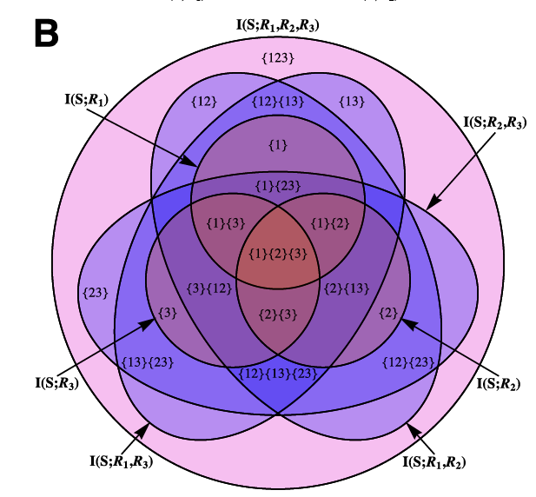
note: information can be partitioned for more than just 2 sources
I’m going to say:
I never saw this
or
(b) I don’t ever have enough data for high dimensional pdfs
or
(c) I’m super lazy
Williams and Beer, 2011

Slide 12
information can be partitioned
(Williams and Beer, 2011)
unique information from each source individually
redundant information
synergistic information provided by sources together
we need a way to compute U, R, or S

Slide 13

how to compute redundancy is open to interpretation
some measures are too large
Williams and Beer, 2010
others might be too small
minimum R in order for all components to be non-negative
we think ours is just (sort of) right
Goodwell and Kumar, WRR 2017
source dependency scaling
Why does this scaling make sense?
R_{MMI}
R_{min}
R_{s}

Slide 14

R_{s} allows for detection of multiple unique components: a die rolling example
partitioning with R_{MMI}
partitioning with R_{s}

Slide 15
R_{s} works well for environmental signals that represent different processes
low I_{s}: independent sources → more unique
high I_{s}: correlated sources → more redundant
5 miles
then
turn left
4
Yeah, it’s 4
X
Y
X
Y
Z
Z
Got it,
thanks team.
I only needed one of you.

Slide 16
time for some logistics
WHAT DO WE HAVE?
(Data!)
WHAT DO WE NEED?
(a PDF!)
WHY DO WE NEED IT?
(to compute information measures and construct process networks to learn interesting things about the dynamics of complex systems!)

Slide 17
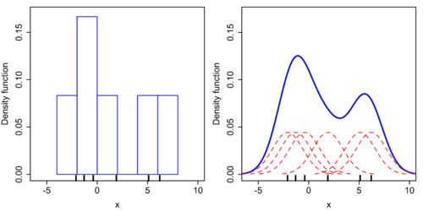
there are many ways to estimate a pdf from data…
Fixed Bin Methods
Kernel Density Estimation (KDE)
Darbellay-Vajda (DV) Adaptive Partitioning
make a Gaussian assumption
OCTree

Slide 18
before computing a pdf, there are also many things we might want to do to prepare our data…
remove outliers
(or not)
normalize data or otherwise transform it
filter or take an anomaly
(for example, to get rid of diurnal or annual cycle)
consider pdfs over multiple time windows
(for example: before and after a storm event)

Slide 19
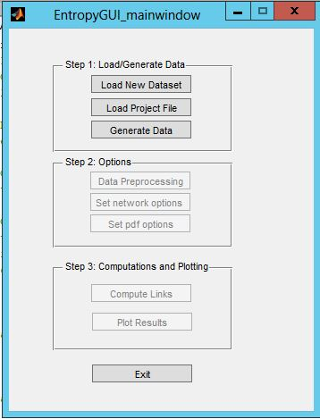
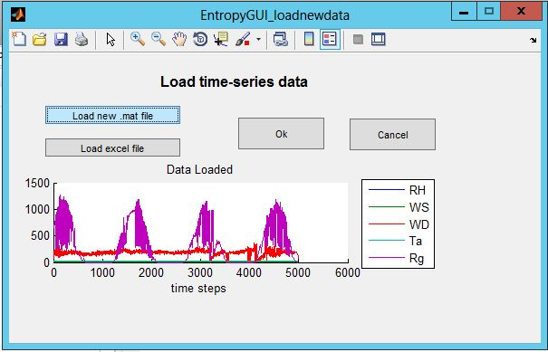
TIPNet: a Matlab GUI
available for your enjoyment at: https://github.com/HydroComplexity/TIPNet
a dataset can either be loaded as a .mat file (must have a matrix named data and a character vector varnames) or as an excel file
data is saved in a .mat project file

Slide 20
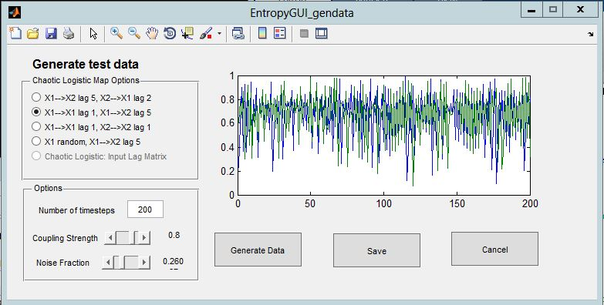
TIPNet GUI: loading or generating a dataset
alternately, you can opt to generate data, where I have a few 2-variable examples set up
several chaotic logistic cases, can fiddle with noise and coupling strength for any case

Slide 21
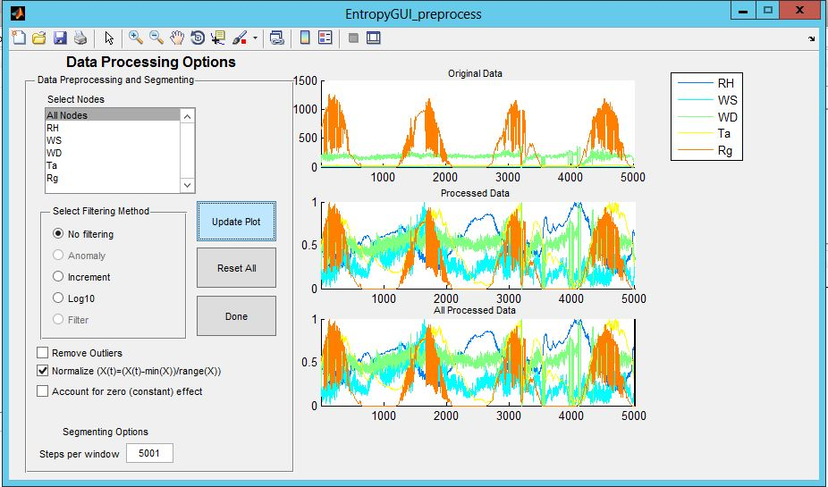
TIPNet GUI: data pre-processing options
select “all nodes” or individual variables, see the data before and after operations such as outlier removal, normalization, anomaly, or filtering

Slide 22
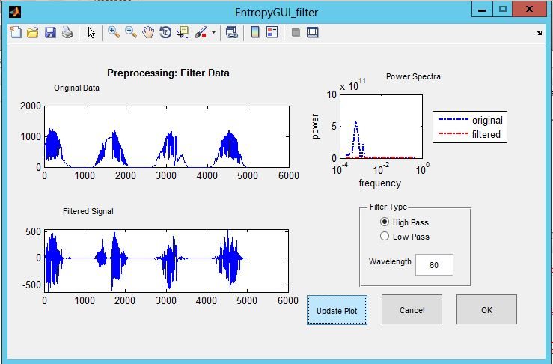
TIPNet GUI: data pre-processing options
If filtering (or anomaly) is selected: will perform a high-pass or low pass Butterworth filter with a given cutoff wavelength
Reason to do this:
We might want to focus on short term fluctuations, or we might want to omit them

Slide 23
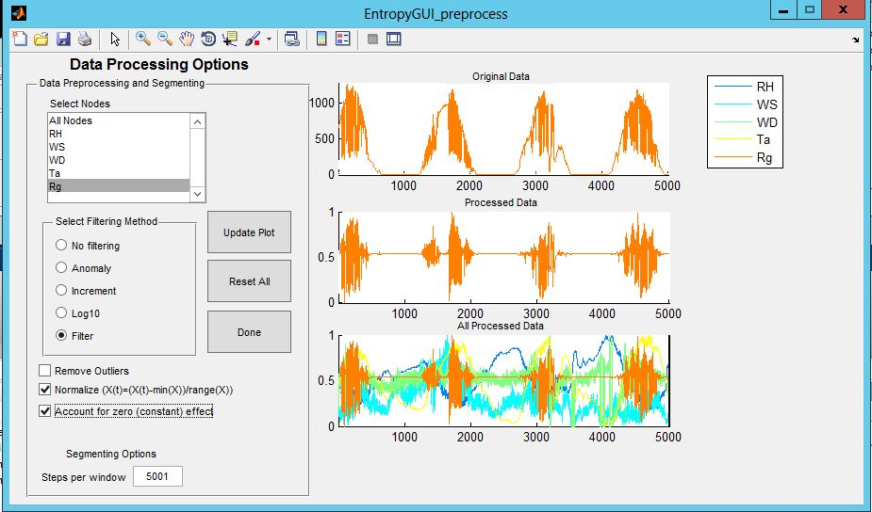
TIPNet GUI: data pre-processing options
If you make a mess: reset everything
option to account for “zero effect” or “atom at zero”
option to compute pdfs over many (equally sized) time windows

Slide 24
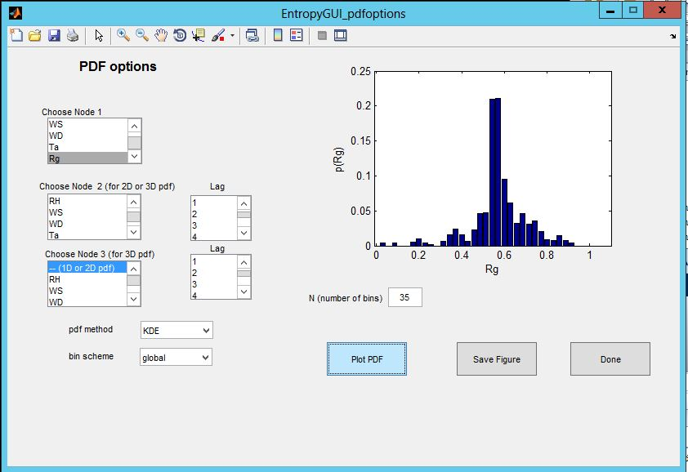
so you have beautiful data, now what?
there are some decisions to be made regarding your pdf estimation
← pdf viewer within TIPNet GUI
options for:
1) Local vs global binning
2) KDE vs fixed binning
3) number of bins (N)

Slide 25
bin scheme: local vs global
*for just one time window → they are the same!
Otherwise, they might be different
for example: say we want 6 bins in our pdf, and two time windows
global binning
local binning
time window 1
time window 2

Slide 26
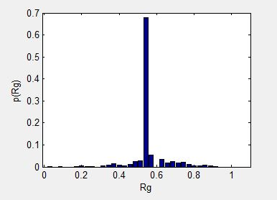
TIPNet GUI: pdf options
zero effect: some data (like precipitation, radiation) have many zero or constant values. When left alone, the KDE method will smooth those values over some surrounding bins. If we don’t want this → accounting for zero effect causes those data points to be considered separately.
~70% of data are constant value.
Here, p(constant value) = 0.7
here, the constant value gets smoothed over several surrounding bins

Slide 27
TIPNet GUI: pdf options
A note on fixed binning vs. KDE:
KDE method uses a C function, that needs to be compiled in Matlab using mex (see user guide), just one time before your first use

Slide 28

side note: there are other pdf estimation issues for real data
skewed data
flow rate, others have long tailed pdfs
solution: can transform to normal distribution
measurement interval vs. bin width
rain gage has 1mm resolution, etc.
solution: make sure bin width > interval
solution: methods to compute optimal bin width

Slide 29
now it’s time to circle back and think about the “network” part of TIPNet
currently, we have a 3-node analysis

Slide 30

moving beyond a three-node analysis requires courage a network approach.
we define a TIPNet as set of {X₁, X₂} pairs that provide R or S and individuals that provide U
Goodwell and Kumar, WRR 2017 (2)

Slide 31
TIPNet defines a U,R,S value for each source→target relationship
X_{s3}
X_{s1}
For multiple sources, our link could be redundant or synergistic with any other link
X_{tar}
X_{s2}
X_{s4}
R, S → are maximum R and S values for that source variable along with any other source variable
U → minimum U for that source value when any other source variable is considered
this way, any given S value from source X to target Y is also associated with some source Z (think of X and Z as “synergy buddies”)

Slide 32
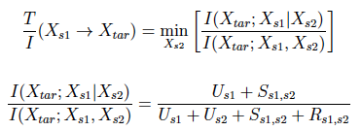
transfer entropy can be re-interpreted as: uniqueness + synergy
X_{s3}
X_{s1}
R_{s1,s2}
R_{s1,s3}
For multiple sources, our link could be redundant or synergistic with any other link
U_{s1}
U_{s2}
U_{s1}
U_{s3}
X_{tar}
S_{s1,s2}
S_{s1,s3}
X_{s2}
R_{s1,s4}
X_{s4}
U_{s1}
U_{s4}
For each source link, we use this ratio as a measure of uniqueness + synergy:
S_{s1,s4}
“T”
min
given all other sources
(X_{s1,}X_{s2,} X_{s3}……)
“I”
Goodwell and Kumar, Entropy 2015
Notes:
can still use decomp to gage overall uniqueness of a link
T/I minimized over all sources is a conservative measure of the uniqueness + synergy of a source link

Slide 33
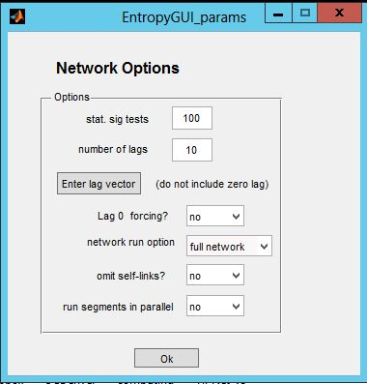
TIPNet GUI: network options
number of statistical significance tests (what are those? wait for it…)
number of time lags you’d like to consider
(should be far less than the length of your time windows)
do you want to consider a 0-lag information relationship as a directional link?
short on time?
can there be a link from X to itself?
for many time windows, can run code in parallel

Slide 34

we use shuffled surrogates to test for statistical significance
1) compute information theory measure, e.g. I(X(t-3);Y)
2) shuffle the X values
X
τ_{x}=3
Y
X(t-3) | Y(t)
x(1) | y(4)
x(2) | y(5)
x(3) | y(6)
… | …
x(n-4) | y(n-1)
x(n-3) | y(n)
3) compute I(X_shuffled;Y)
4) shuffle X again and repeat lots of times, e.g. 100
shuffle!!!
…

Slide 35
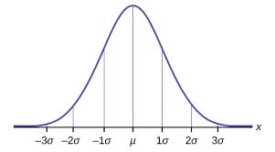
statistical significance continued….
5) find the mean I(X_shuffled;Y) and standard deviation = μ and σ estimates
6) let’s assume values normally distributed
7) set threshold value, e.g. μ+3σ (for 99.9% confidence level)
8) is I(X(t-3);Y) > threshold?
not significant
☹, no link
not significant
☹, no link
significant link! ☺
Another method:
normalize the information measure, and set some cutoff threshold, e.g. I(X(t-3);Y)<0.05

Slide 36
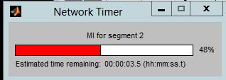
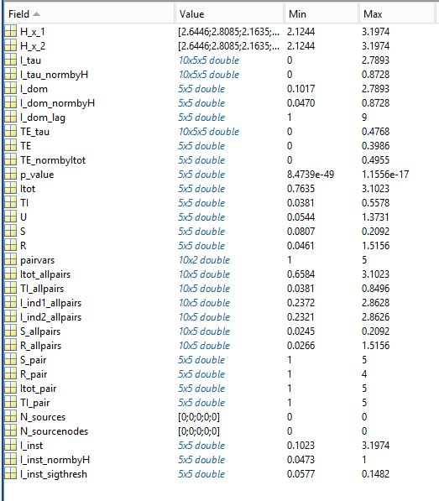
TIPNet outputs: all the information measures
depending on your data size and options (esp. pdf options), this could take a minute….
← this tiny text image is showing all the outputs of TIPNet saved in a variable called “entropy” that is saved in your project file. It includes: entropy, mutual information, time lags, transfer entropy, T/I, and synergistic, redundant, and unique information components, and “synergy and redundancy buddy nodes”

Slide 37
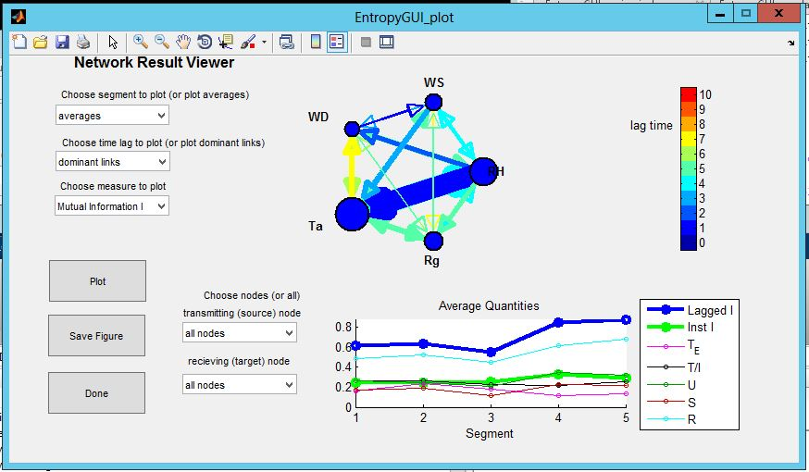
TIPNet GUI: result viewer
Colors indicate dominant lag times, sizes indicate strengths of different metrics
if there are multiple time windows, this plots temporal variation in different metrics

Slide 38
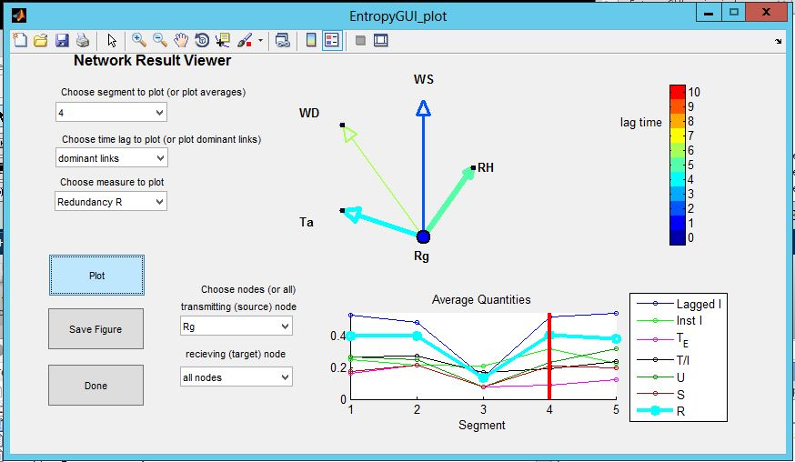
TIPNet GUI: result viewer
Also have option to plot particular dependencies – e.g. from a single source to multiple targets

Slide 39
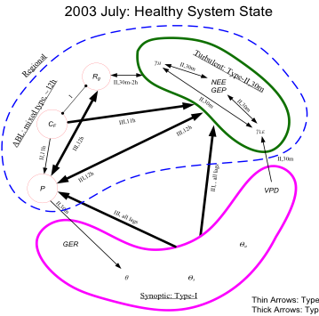
caveat on result viewer
plenty of things it doesn’t show us – mainly meant for use as an initial visualization tool
Many other ways in which we might want to consider network results

Slide 40
example uses of TIPNet measures (if not the actual GUI)

Slide 41
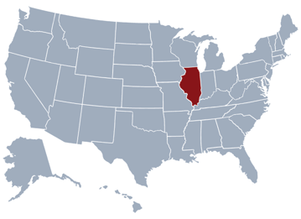
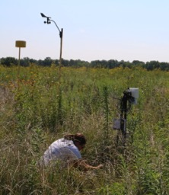
example 1: Sangamon weather station data
Sangamon Forest Preserve
Intensively Managed Landscapes (IML) CZO
relative humidity
solar radiation
precipitation
air temperature
1-minute resolution
180 days
May-Oct 2015
wind speed
leaf wetness
segment into 4 windows per day

Slide 42
information strength and type change between time windows
bits

Slide 43
example 2: Sangamon weather station process network
Daily networks averaged over a growing season – overall behaviors for different wetness conditions
Goodwell and Kumar, WRR 2017 (2)

Slide 44
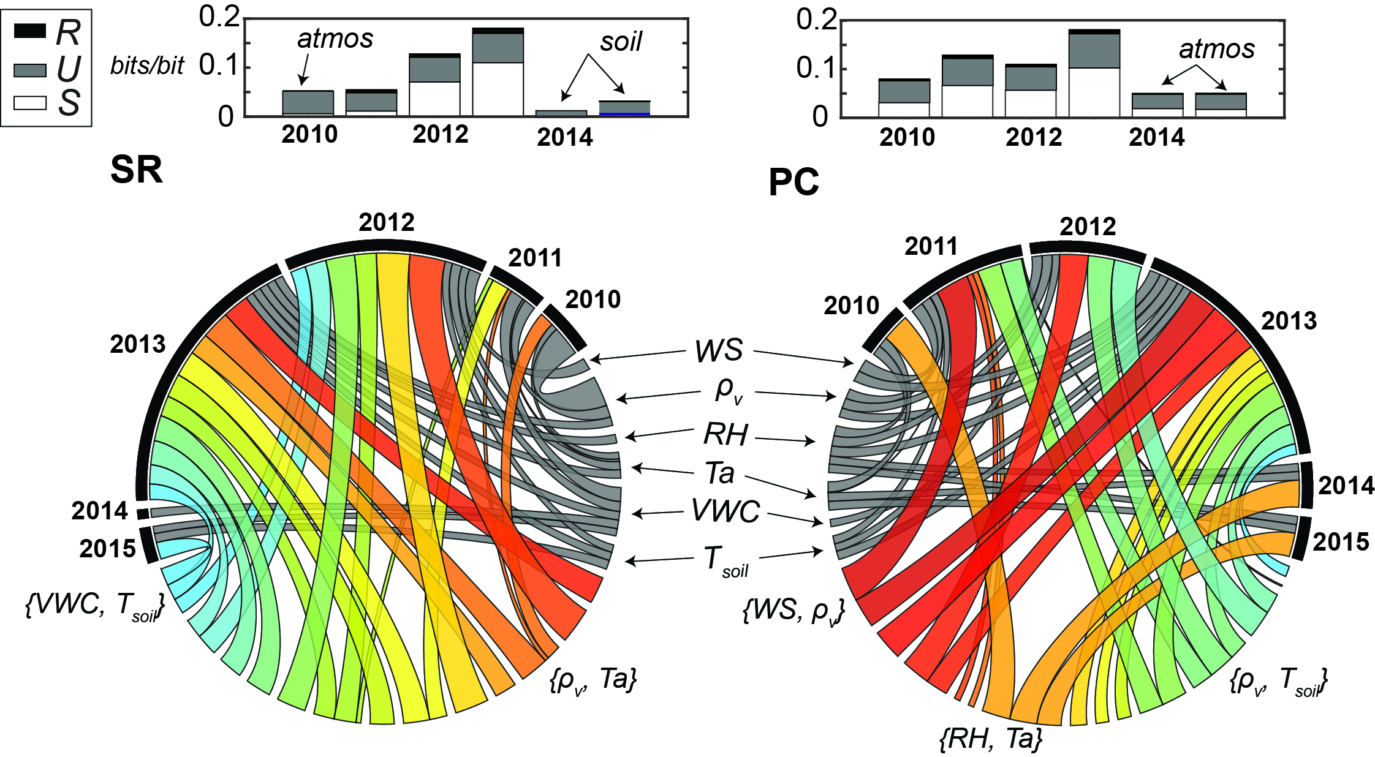
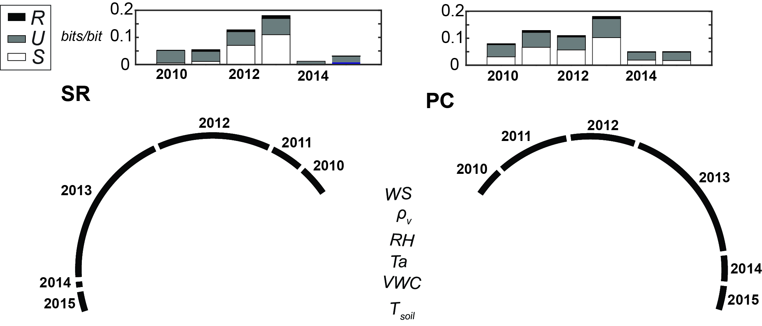
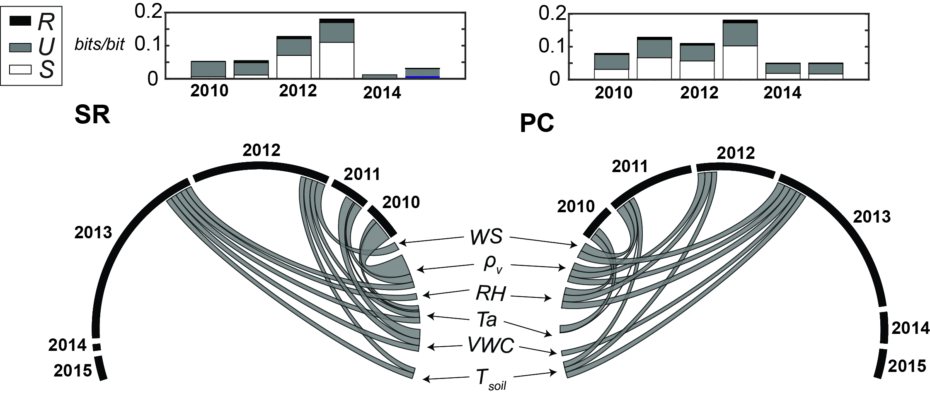
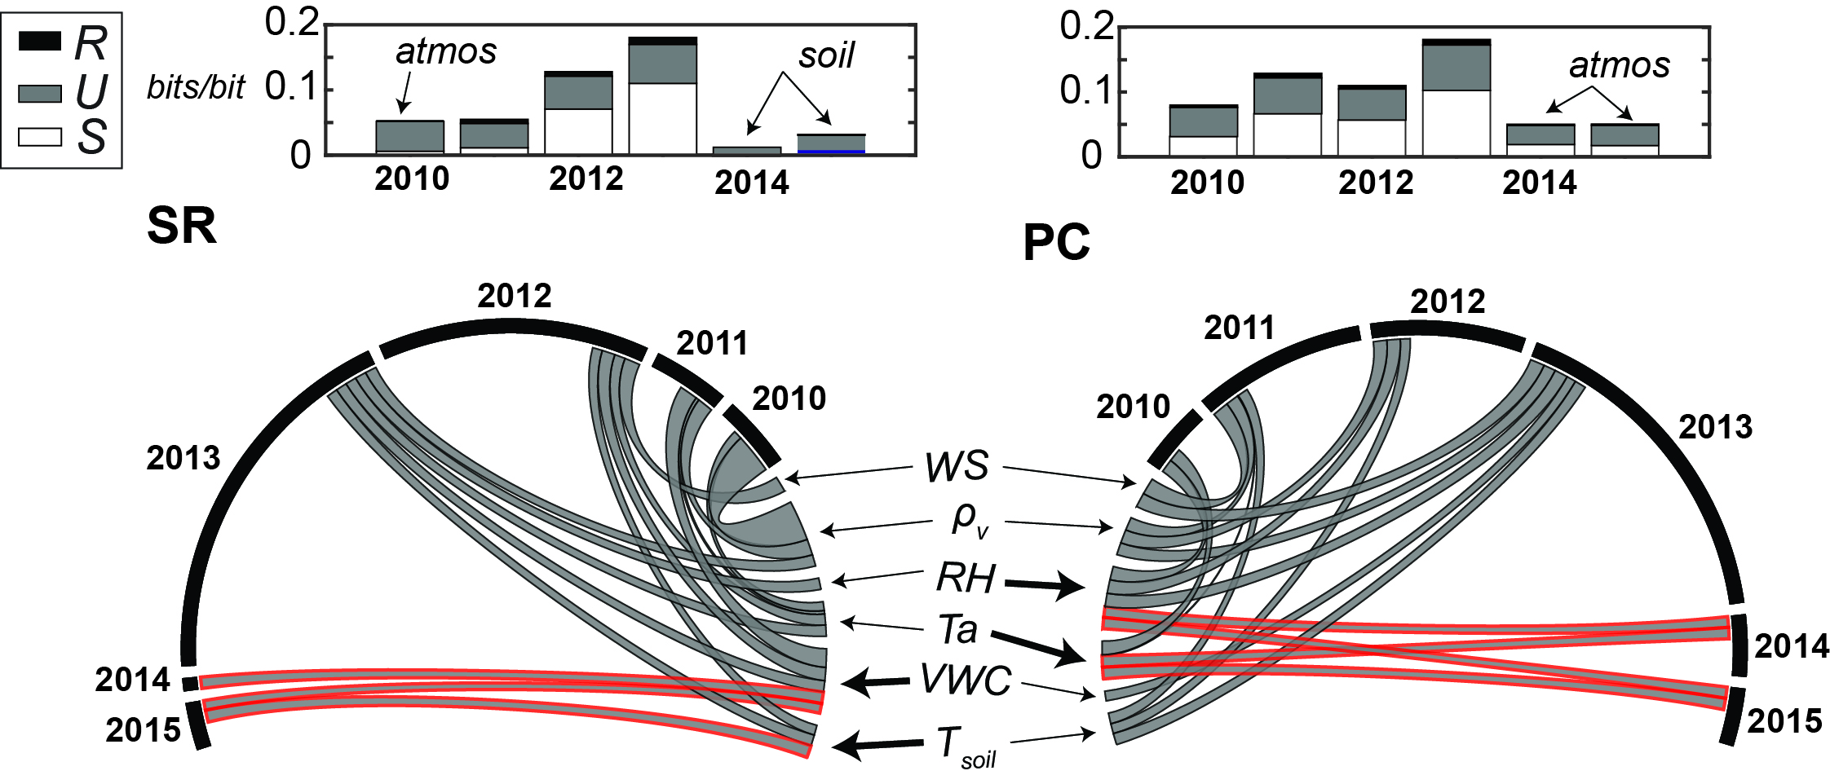
example 3: connectivity changes during the California drought at flux tower sites
Goodwell and Kumar, PNAS 2018 (in review)

Slide 45
example 3 continued: network measures vs. changes in fluxes

Slide 46
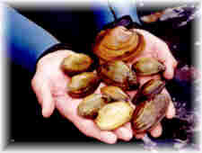
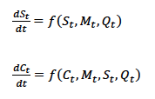
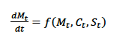
example 4: data-model relationships
Coupled non-linear equations simulate native mussel population over time
← nice friendly Minnesota native mussels
3 sites:
Chippewa – dynamic mussels
*here we looked at many initial conditions (Mo)
St. Croix – happy healthy mussels
Redwood – sad extirpated mussels
Hansen et al. 2015

Slide 47
Normalized Data → pdfs → Entropy H(X)
Notes:
normalized data and 1D pdfs for range of Mo conditions (and Mo equivalents for Redwood and St. Croix), associated entropy
method: kernel density estimation, N=50, n=10,000 data points
*for each of 13 cases: got rid of outliers for M_inc and upper outliers for C
*normalization: normalize log(Q) separately for each site to be between [0 1], normalize other variables according to overall max and min values to between [0 1]
Chippewa cases shown in colors, Redwood gray, St. Croix black
notes:
although Q differs by order of magnitude between cases, similar pdf among three sites once normalized, similar entropies between sites
C has bimodal distribution for many cases – represents 2 states where mussels are dynamic at beginning and then either extirpate or become stable
However, for high Mo Chippewa cases (warm colors), mussel population immediately wipes out C, and H(C ) = 0 == C is no longer variable
S always very low for St. Croix (H(S)=0 for St. Croix – black diamond), more spread for Redwood (highly variable sediment)
M_inc most variable for St. Croix (largest postitive increments compared to other cases – highest H(Minc)), very low H(M_inc) for low Mo cases and Redwood

Slide 48
most links for dynamic cases
Lagged I
Chippewa
Lagged I
Redwood and St. Croix
Notes:
network figures (note Q is now on top, M_inc on bottom) for different cases: lagged mutual information (top) and T/I (bottom)
Chippewa Mo=.15 very similar to Redwood extirpation case
Chippewa Mo=7 not as similar to St. Croix healthy case – C is more dynamic in St. Croix case, still influences M_inc
we observe completely connected network for the dynamic case for Chippewa, and very redundant (low T/I) links. For low Mo cases, M_inc has no influence on other nodes, and links between C and S are more unique. For high Mo cases, S and C have no (or less) influence on M_inc. C→C self-link is completely unique (since it is the only link)

Slide 49
other ways to analyze networks
node dump,
thresholds of I(X;Y)
behavior of modeled vs observed data
clustering into subsystems
consider storm events
categorizing time windows by wetness condition, other types…
reduced complexity models,
daily flow data

Slide 50

Questions?
allison.goodwell@ucdenver.edu
https://github.com/HydroComplexity/TIPNet

